Slide 1
BIOSAFETY COMMUNICATION & ENGAGEMENT IN SOUTH AFRICA
Hennie Groenewald (PhD) & Jhill Johns
FAO food biotech communications toolkit development meeting, Online – 12 June 2020

Slide 2
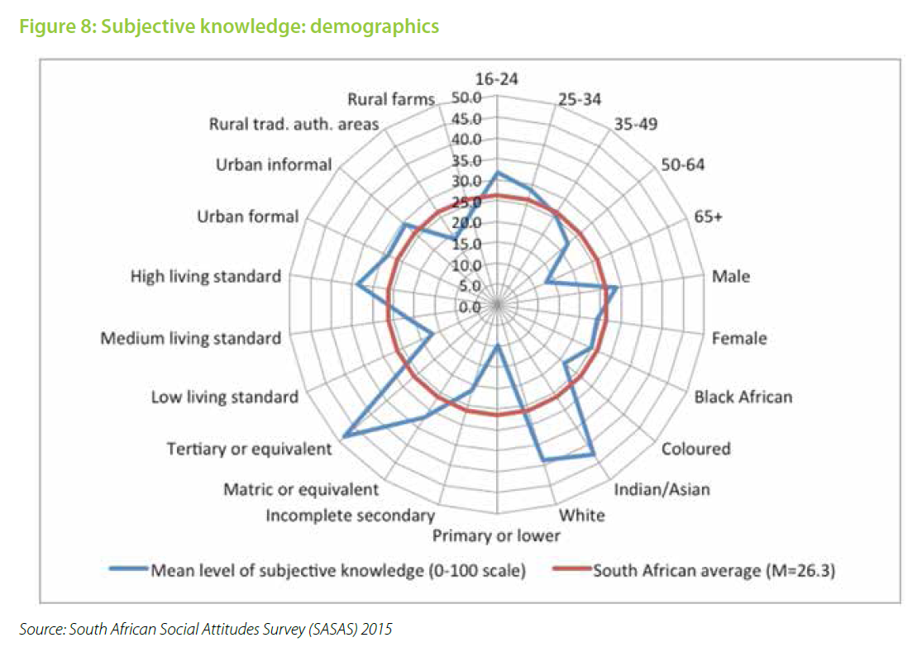
Challenges
General audience indifference (but within a context of echophilosophy communication vehemence)
Societal/audience diversity
Identifying the most relevant (context-specific) messages
Technical nature of the topic
Communication ownership, commitment & capacity
South Africans’ self-proclaimed knowledge of “biotechnology”
2

Slide 3
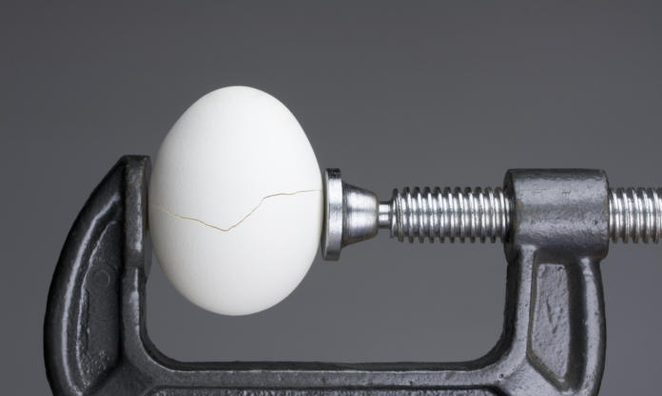
GM-food has become one of the defining battlegrounds of the perpetual conflict between two contrasting value systems
SOCIETAL
TECHNICAL
molecular biology & genetics
Evolving consumer trends , e.g. “natural”
assessment of biorisk
unclear benefits
Accessibility of misinfo
risk perceptions & uncertainty
globalisation, business rivalry, ownership & protest industry
Contrasting world views, value systems & disconnected consumers
GM-f
od
what
who
3
© Biosafety SA
3

Slide 4
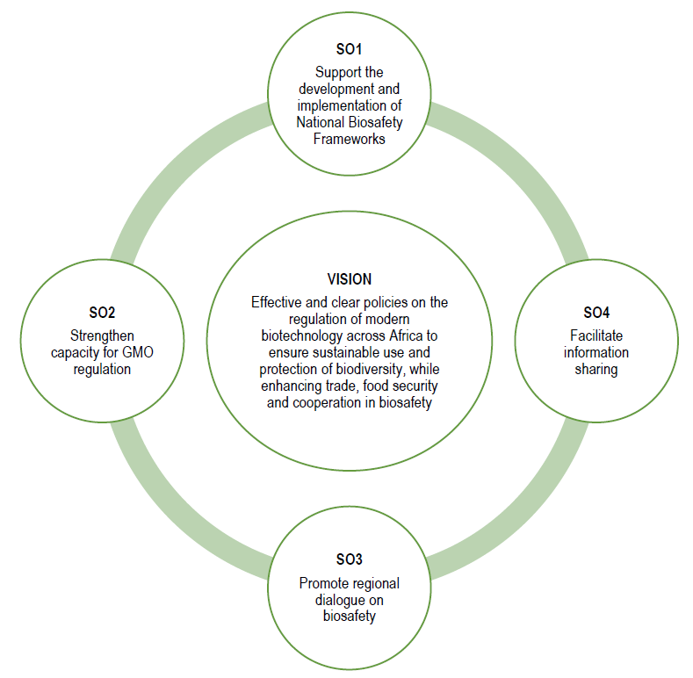
What did your country do?
Context – commercialized GM crops in 1997
South African Agency for Science and Technology Advancement’s (SAASTA’s) Public Understanding of Biotechnology (PUB) program 2003 (2001 National Biotech Strategy)
National Biotech Surveys 2004 & 2015 – accurate data required as basis for decision making & monitor progress
Biosafety SA – National Biosafety Communication Strategy 2015
Regional Engagement Strategy 2018
Annual National Sustainable Biotech Innovation Symposium since 2018
PBI consumer perceptions survey 2020
Regional Engagement Strategy
4

Slide 5
What worked and what did not work in your country?
Works
Clear ownership, develop capacity & use networks
Focussed & aligned interventions, e.g. schools & post-graduate programs
Strategic collaborations
Doesn’t work
Ad hoc activities
A “cold” approach - expecting interest (our video clip competition)
Questionable (requires a focussed approach)
Social media campaigns
General audience exhibitions
5

Slide 6
What do consumers need to know?
Consumer ≠ consumer ≠ consumer
Need confidence in product (food) and governance systems
Majority arguably only needs to know that the information is available and won’t really engaging with it – assurance of transparency
6

Slide 7
What do consumers want to know?
Depends on the consumer…
Who is responsible
Are their concerns being addressed
Understanding why, e.g. comparative info, alternatives/lack thereof.
p.t.o.
7

Slide 8
LESSONS LEARNT
Not enough to regulate, must also be seen to be regulating
Build public confidence in the biosafety system
Build & integrate relevant competencies / institutional support
There will always be disagreements regarding decisions
Transparency and consultation is vital, but can only be done up to a point
Continue to evolve and grow confidence
Realise the value of biotech/GMOs/gene editing for local innovation
Communication & engagement has become an essential part of governance
8

Slide 9
Example 1
9

Slide 10
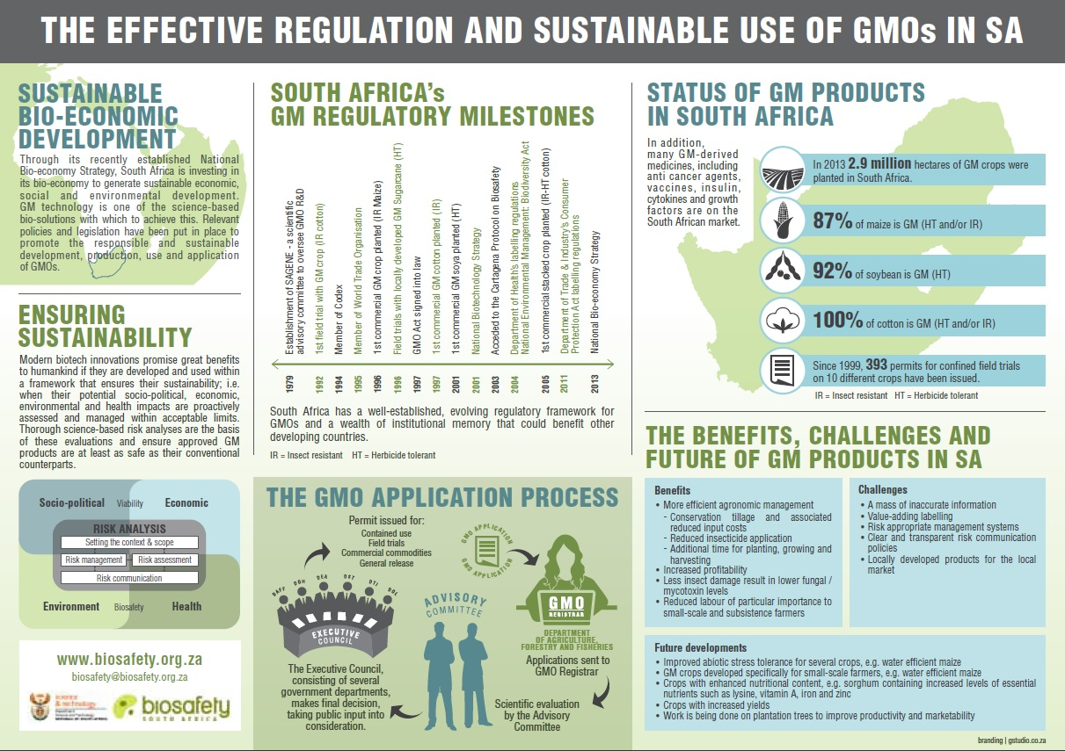
Example 2
10

Slide 11
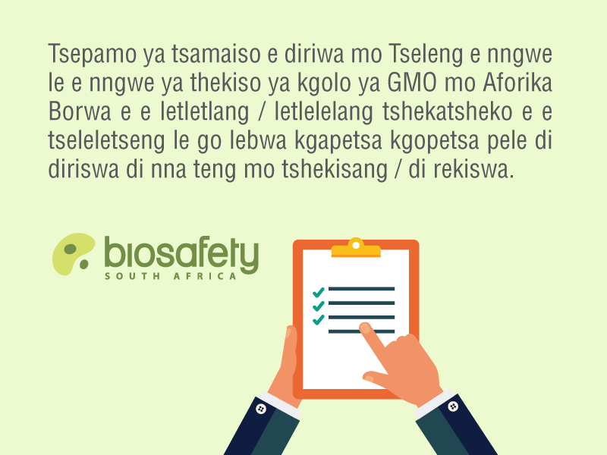
Example 3
11

Slide 12
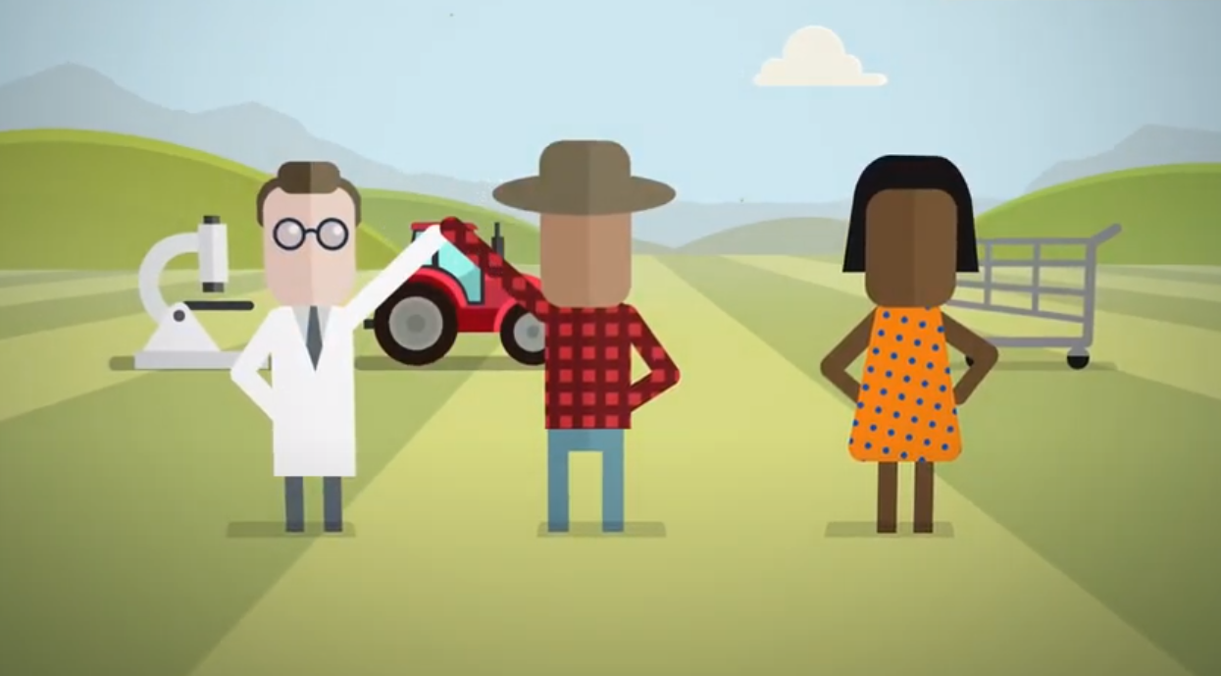
Example 4
GMOs & Biosafety in South Africa
https://www.youtube.com/watch?v=TiXLWPOiqxc&t=4s
12

Slide 13
Essential elements for the toolkit
Key messages
Note: messages should always be context specific
Messages that inform and instil confidence in the governance framework
Messages that emphasise the value of biotech foods
Recommendations
Conceptual
p.t.o.
Practical
Simplicity: simple appropriate language to convey concepts & principles
Visual: use images to illustrate concepts/context
Familiarity: analogies (est. starting point/common ground)
Storyboards: to frame/capture and facilitate dialogue, enquiry and engagement
13
Notes:
Potential NOT SOLUTION. Solution is often interpreted as final i.e. a decision was made. Potential is not final... this often collapses a myriad of misperceptions around governance of bio-innovations.
Storyboard captures important bio concepts. It enables both broad and targeted conversations, depending on consumer interest.

Slide 14
How to communicate effectively
TRUST > knowledge
Start with WHY
Get diverse allies to vouch for sound information
Seeing is believing!
© Biosafety SA
14
Notes:
The deficit model of science communication (educate and people will realise they are wrong) does NOT work! They must 1st trust you before they will listen to you. Trust = credibility + motivation to be truthful + warmth. It therefore matters HOW you communicate.
Why first – human interest/significance, then only how & what. Mention data from UK – genome editing acceptance varies based on application (not as a principle). Not only diversity ito technical expertise, but also value systems – people rather listen to people they can identify with (same tribe). Success (experienced benefit) is the best way to communicate! Compare GM food with rDNA medicines – pto...

Slide 15
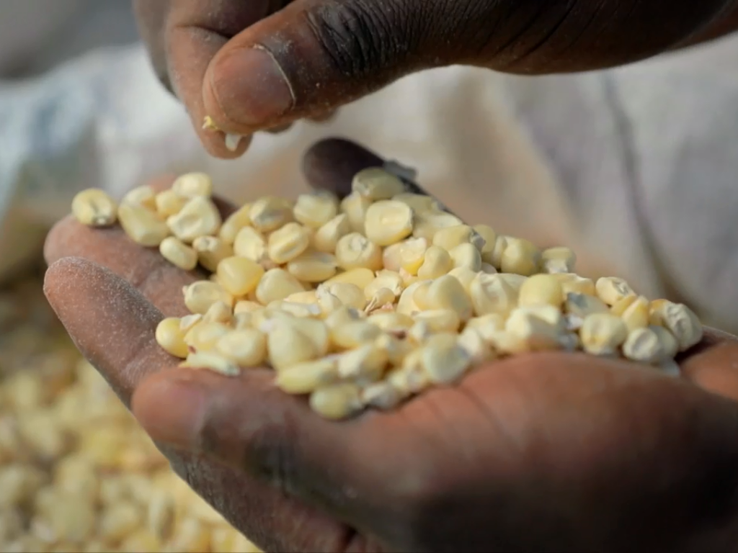
Thank you!
Jhill Johns⏐ jhill@biosafety.org.za
Hennie Groenewald ⏐ hennie@biosafety.org.za
www.biosafety.org.za

